Slide 1
McNair Academic Writing

Slide 2
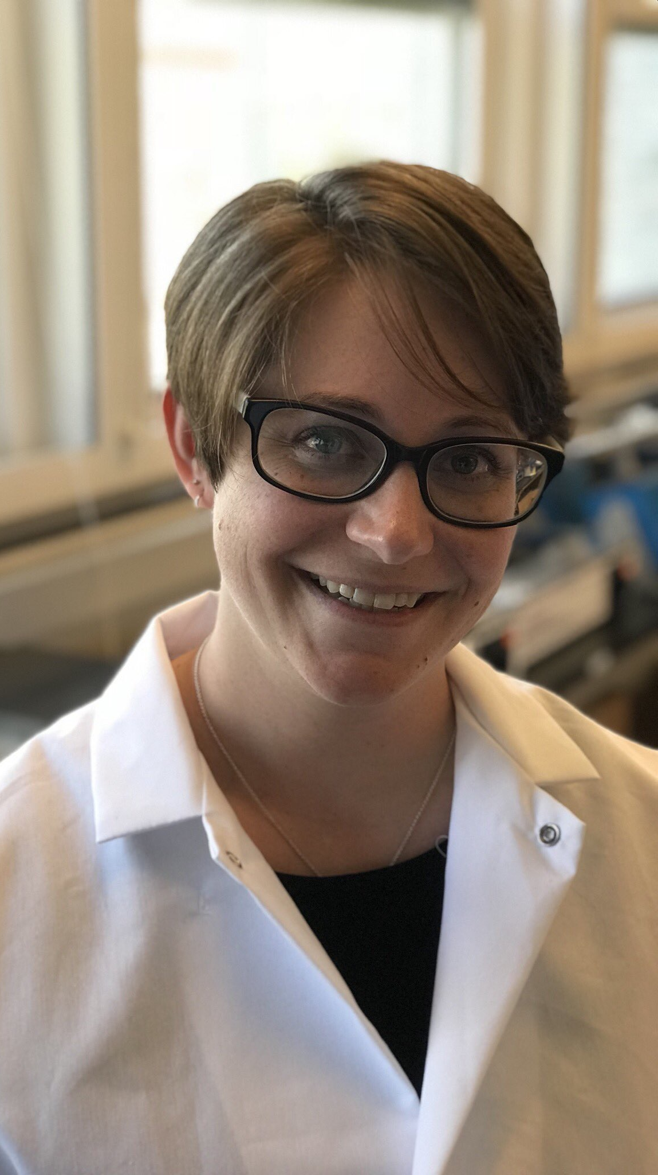
Heather Who?
University of Wyoming – Class of 2010
B.S. Microbiology/Physiology
McNair Scholar
7 out of 7 grants
University of Nebraska Medical Center – Class of 2017
Ph.D. Biochemistry and Molecular Biology
6 first-author publications, 3 out of 3 grants
Oregon National Primate Research Center
Postdoc
1 first-author publication (in prep), 2 out of 4 grants

Slide 3


Who are You?
Getting to Know You: Student Introduction and Preferences
Writing Attitude Survey
Notes:
https://poorvucenter.yale.edu/strategic-resources-digital-publications/managing-classroom/developing-pre-course-survey
https://dl.sps.northwestern.edu/blog/2018/04/write-pre-course-survey-questionnaire/

Slide 4
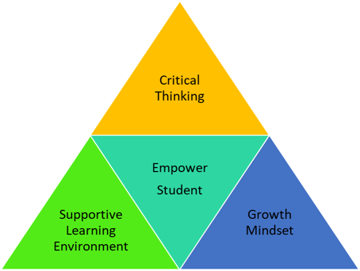
Teaching Philosophy
“If a [student] can't learn the way we teach, maybe we should teach the way they learn” -Ignacio Estrada
My goal is to focus on teaching the way you learn and empowering each of you to reach your maximum potential.

Slide 5


Supportive Learning Environment

Slide 6

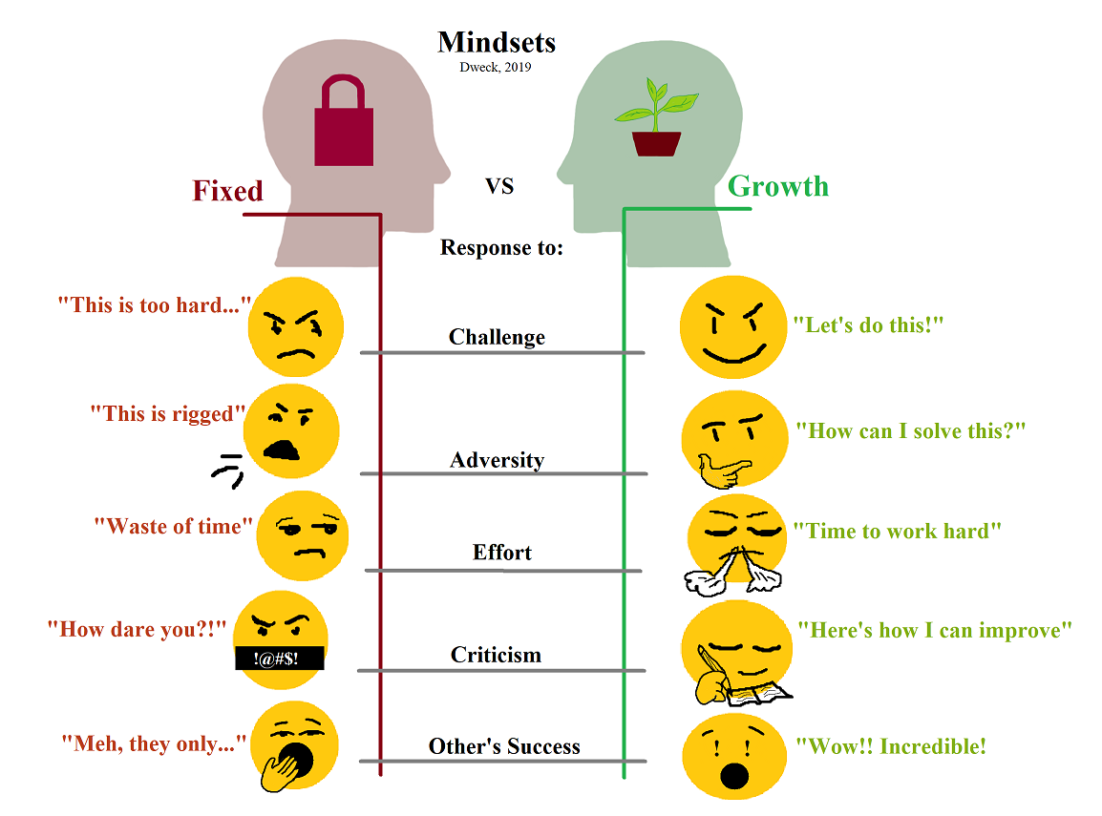
Growth Mindset
Notes:
https://upload.wikimedia.org/wikipedia/commons/0/09/Fixed_and_growth_mindsets.png

Slide 7
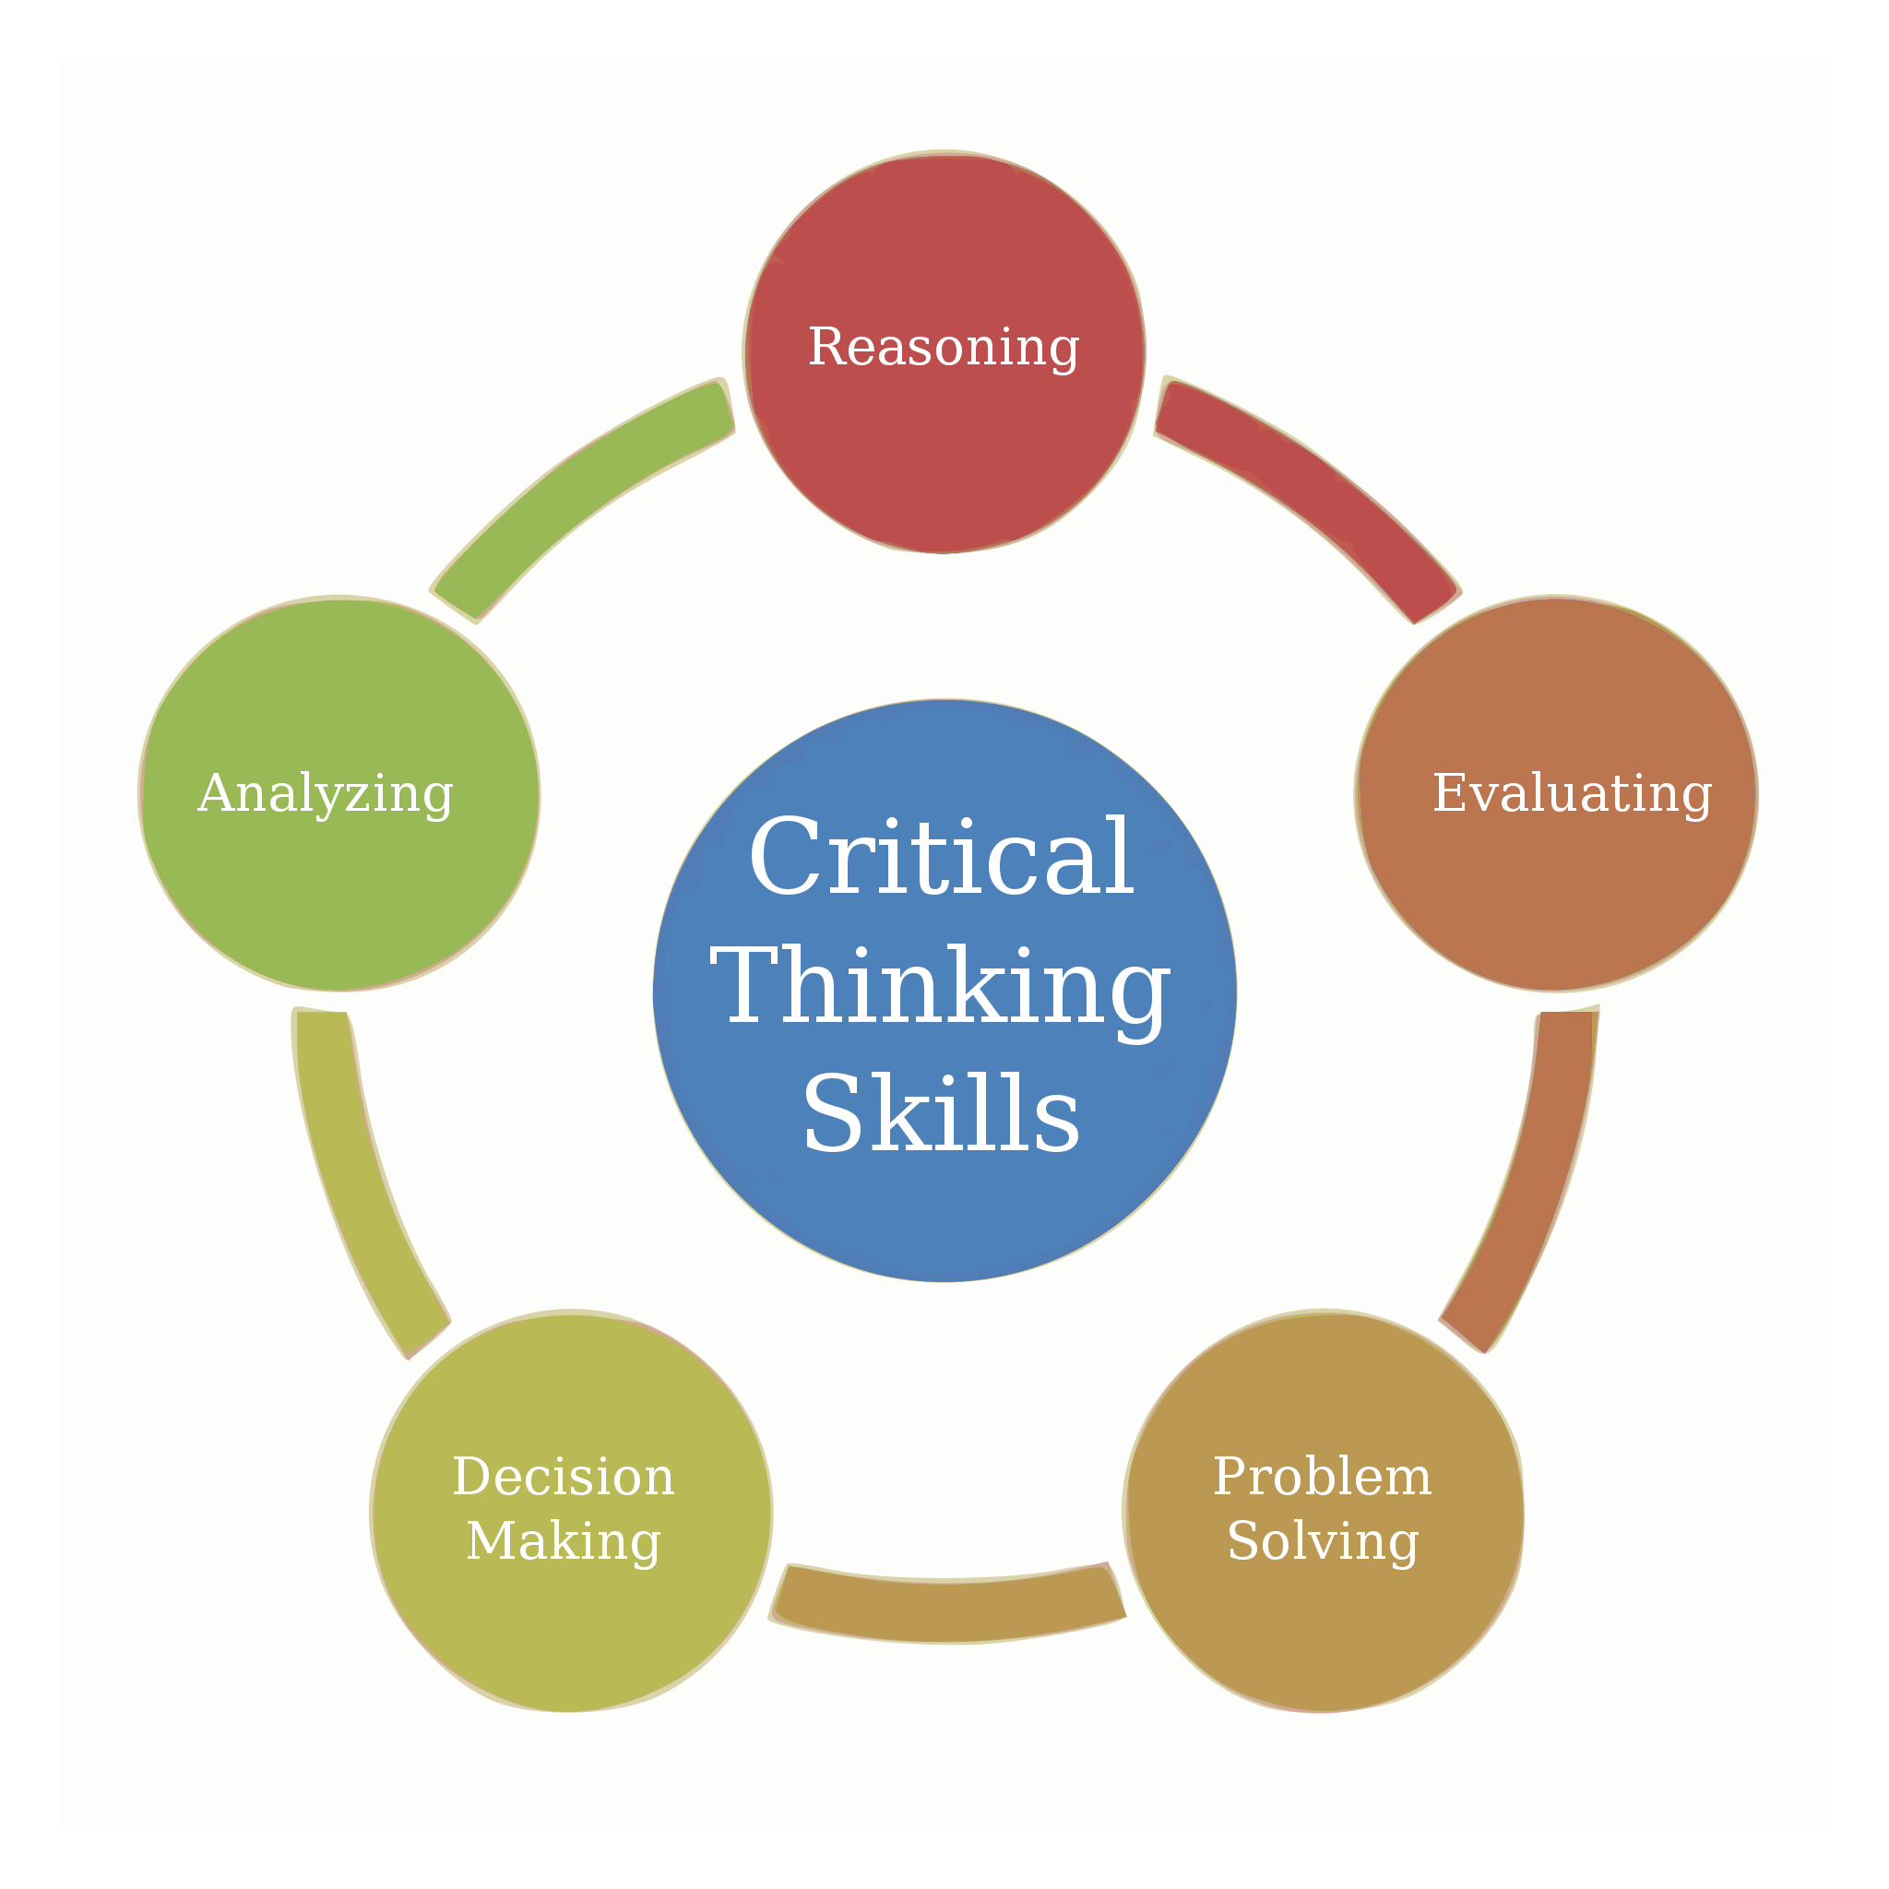
Critical Thinking
Notes:
https://upload.wikimedia.org/wikipedia/commons/thumb/2/20/Critical_Thinking_Skills_Diagram.svg/2048px-Critical_Thinking_Skills_Diagram.svg.png
https://innovativeteachingideas.com/blog/critical-thinking-for-teachers-and-students

Slide 8

Course Goals
Writing a submission-ready academic paper
Assessing and reflecting on personal writing process
Skills and tools to succeed at academic writing in graduate school

Slide 9


Academic Paper

Slide 10
Course Goals
Writing a submission-ready academic paper
Assessing and reflecting on personal writing process
Skills and tools to succeed at academic writing in graduate school

Slide 11
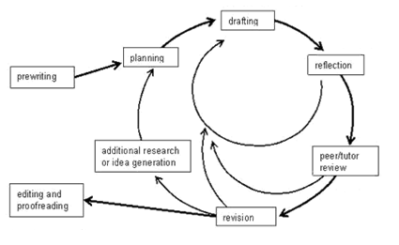

Writing Process
Notes:
https://www.lirvin.net/WGuides/wprocess.htm

Slide 12
Course Goals
Writing a submission-ready academic paper
Assessing and reflecting on personal writing process
Skills and tools to succeed at academic writing in graduate school

Slide 13
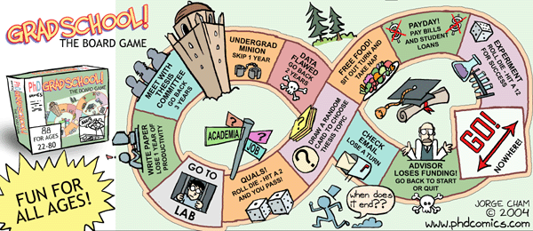
Grad School Map
Notes:
https://phdcomics.com/comics/archive.php?comicid=515

Slide 14
How?
Each week focus on one part of a typical academic paper
Lecture, workshop, and small group discussions
Groups of 3 will be reviewing each other’s work each week.
IMRaD (or AIMRaD) is now standard for ~90% of all papers.
(Abstract)
Introduction (6/06)
Methods (6/13)
Results (6/20)
and
Discussion (6/27)
Notes:
social sciences, natural sciences, or engineering and computer sciences

Slide 15
Schedule
Class: Tuesday 2-4 PM MST
Discord writing study hall

Slide 16
New Course Structure and Goals
Need your feedback throughout the process
Rate It! Fist to Five
Completely Understand
Mostly Understand
Understand Pretty Well
Could Use Practice
Need Help
Don’t Understand at All

